Slide 1

Delegated Healthcare Interventions
(aka ‘delegated tasks’)
Ivan Olbrechts
December, 2022
VODG L&D Pro Network Meeting

Slide 2
Background
What is a “delegated task”?
Who can delegate?
Who is responsible?
What are the safety and governance issues?
What might good governance look like?
Skills for Care / ‘York’ Report & National Framework
Interim actions

Slide 3

Background
The Cavendish Review (2013) of Healthcare Assistants and Support Workers in the NHS and social care settings.
The independent review found that boundaries between nurses and HCA’s were “blurring” and this was felt keenly by both groups (and affected effective and safe delegation of healthcare interventions)
Report recommendations included:
  Recruitment, education and training (Care Certificate)
  Career development
  Leadership, supervision and support
N.b. this presentation focusses on the delegatee in social care (typically, a support worker) and the delegatee’s employer.

Slide 4
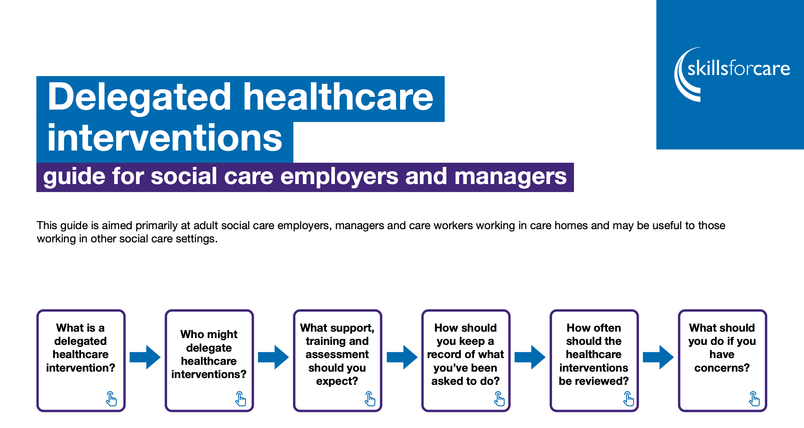
Skills for Care

Slide 5
What is a “delegated task”?
A delegated healthcare intervention is a health intervention or activity usually of a clinical nature, that a registered healthcare professional delegates to a paid care worker.
The type of delegated healthcare intervention will depend on the agreed protocol in your organisation and local health and care system.
A registered healthcare professional remains accountable for the appropriateness of the delegation and ensuring that the person they are delegating to can do the intervention.
Examples include:
Supporting a person’s nutrition using a PEG (Percutaneous endoscopic gastrostomy).
Supporting a person to manage their diabetes through insulin administration and monitoring.

Slide 6
Who can delegate?
Due to the increased complexity of some people’s care needs, social care workers are often regarded as ‘best placed’ to do healthcare interventions as they usually know people well and can deliver consistent person-centred care.
Interventions should only be delegated if in the best interests of the person and by a registered healthcare professional who has the relevant occupational competence relating to the intervention.
Examples of delegators:
Registered nurses
Nursing associates
Occupational therapists
Speech and language therapists
Physiotherapists

Slide 7
Who is responsible?
The employer is responsible for making sure that the care worker has received sufficient training, support and supervision to carry out interventions safely and competently and should be within the care workers job description.
The employer must not allow staff to accept interventions that they are not competent to deliver and without sufficient training and support.
A care worker must not carry out any delegated healthcare interventions that they do not feel they have the skills for or sufficient training.

Slide 8
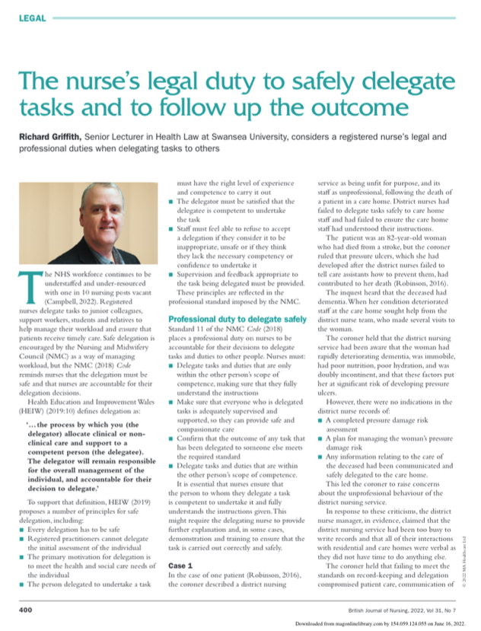
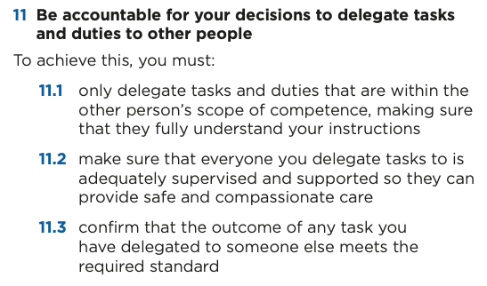

Who else is responsible?

Slide 9
What are the safety and governance issues?
Inappropriate or unsafe delegation
Training, competence and experience
Agency, bank or part-time staff (i.e. less supervision and training)
Record keeping
Support and supervision
Policy, procedures and protocols
Managerial (and organisational) ‘line of sight’
Job descriptions

Slide 10
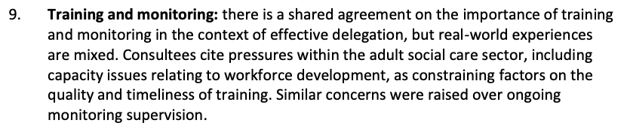
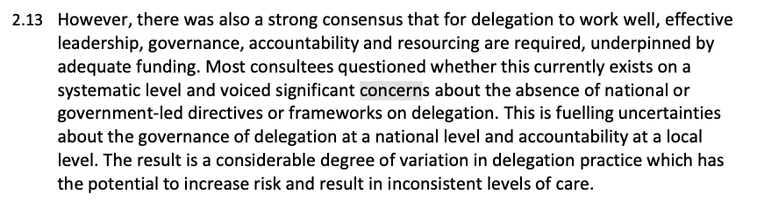
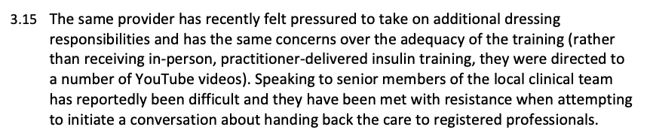
SfC’s ‘York’ Report

Slide 11
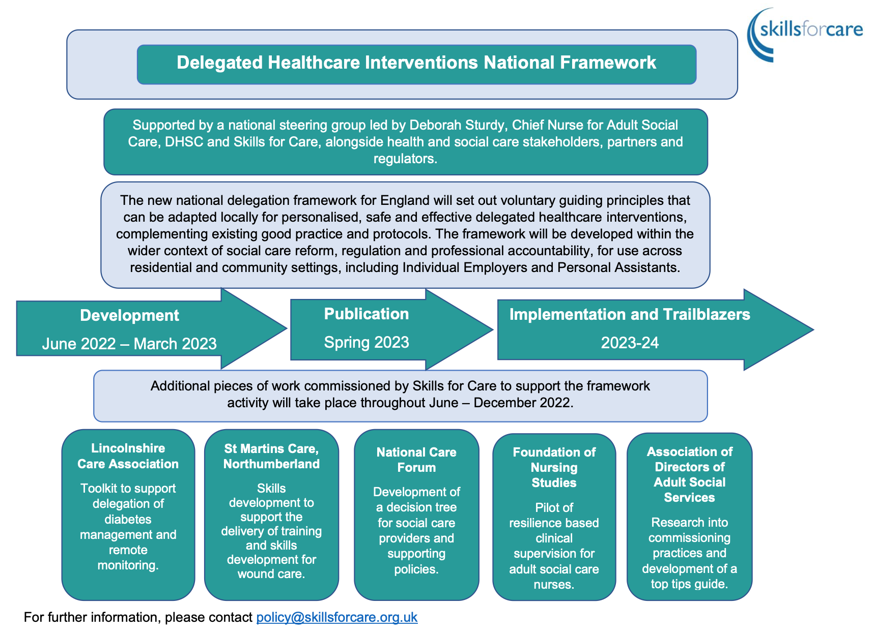
A Cunning Plan?

Slide 12
Interim Suggestions?
Review your governance of delegated tasks.
Record everything ‘delegated’ to your employees.
Identify and address inappropriate, unsafe and unsustainable delegation.
Ensure that your staff can undertake delegated tasks safely and competently.
Ensure that tasks accepted through delegation are sustainable and that there is a written route for escalation of issues and concerns.

Slide 13
£?

Slide 14

References

Slide 15
References
The Cavendish Review:
https://assets.publishing.service.gov.uk/government/uploads/system/uploads/attachment_data/file/236212/Cavendish_Review.pdf
Skills for Care: Delegated Healthcare Interventions:
https://www.skillsforcare.org.uk/Learning-development/ongoing-learning-and-development/Delegated-healthcare-interventions/Delegated-healthcare-Interventions.aspx
NMC: The Code:
https://www.nmc.org.uk/standards/code/
The Nurse’s Legal Duty:
Griffith R., 2022. The nurse's legal duty to safely delegate tasks and to follow up the outcome. British journal of nursing (Mark Allen Publishing), 31(7), 400–401.
Research into social care workers undertaking healthcare interventions:
https://www.skillsforcare.org.uk/resources/documents/Developing-your-workforce/Care-topics/Delegated-healthcare-interventions/Research-into-social-care-workers-undertaking-healthcare-interventions.pdf
DHSC: DHI national framework:
https://www.skillsforcare.org.uk/resources/documents/Developing-your-workforce/Care-topics/Delegated-healthcare-interventions/Delegated-healthcare-interventions-framework-communication-July-2022.pdf

