Slide 1

Local Government Reorganisation Update
VODG Member Update
October 2026

Slide 2


Local Government Reorganisation
LGR is the process of restructuring local councils.
The Government's main proposal is to replace the remaining two-tier system with single-tier unitary authorities, responsible for the full range of local government services.
The Government's original ambition was to
  create simpler, clearer and more sustainable local government
  reduce duplication and fragmentation
  make accountability easier for residents
  release efficiencies to reinvest in frontline services.
Notes:
Strategic Authorities are overarching regional public bodies in England that bring together multiple local councils to drive economic growth, infrastructure, and public services across a wider geographical

Slide 3
Local Government Reorganisation
LGR is intended to support wider public service reform and devolution.
The Government see larger, strategically capable councils as better placed to join up services around communities, focus more on prevention, support economic growth and work alongside new mayoral structures.
For social care and the VCFSE sector, this has been pitched as creating opportunities for more integrated and preventative approaches, but there has already been significant disruption to commissioning, provider relationships and continuity of services.

Slide 4
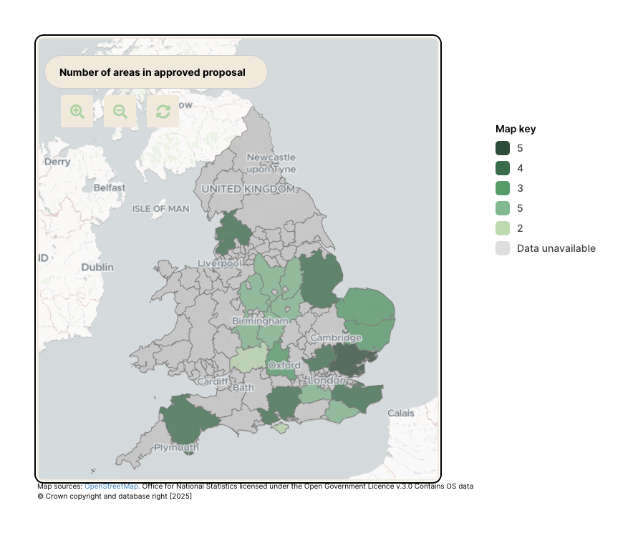
Notes:
Source: Polimapper
Key shows proposed number of new authorities in an area.
Contact research.policy@vodg.org.uk for the link.

Slide 5
LGR Update – October 2026
In September 2026, a swift review of LGR proposals and arrangements was called by the Local Government Secretary.
As of October, the Government has completed the first phase of its review and Ministers are assured that existing reorganisation criteria remains robust and aligned with the Government’s priorities.
A Written Ministerial Statement by Jim McMahon MP OBE on 29 October 2026 confirmed that the Government are minded to proceed with proposals for five areas, while 15 areas have had proposals withdrawn and are now under consideration.
A further update will be provided by the Government before Christmas 2026, and final decisions are due in early 2027.

Slide 6
WITHDRAWN
In September, the Government withdrew the existing decisions for:
Essex, Southend-on-Sea and Thurrock
Hampshire, Isle of Wight, Portsmouth and Southampton
Norfolk
Suffolk

Slide 7
WITHDRAWN (Cont.)
In October, the Government additionally withdrew the existing decisions for:
Derbyshire and Derby
Devon, Plymouth and Torbay
Hertfordshire
Kent and Midway
Lancashire, Blackburn with Darwen and Blackpool
Leicestershire, Leicester and Rutland
Lincolnshire, North Lincolnshire and North East Lincolnshire
Nottinghamshire and Nottingham
Staffordshire and Stoke-on-Trent

Slide 8
WITHDRAWN (Cont.)
Withdrawing decisions does not mean reorganisation has been cancelled - all options remain under consideration.
All areas with previous decisions will receive half their allocated transition funding - £450,000 per previously announced new unitary authority - to cover costs incurred in implementing LGR.
Cambridgeshire and Peterborough and West Sussex will each receive £500,000 as decisions have yet to be made.
Further funding allocations will be determined following final decisions.

Slide 9
MINISTERS MINDED TO PROCEED
In October 2026, the five areas the Minister stated the Government were minded to proceed:
East Sussex and Brighton & Hove (two unitaries + boundary changes)
Gloucestershire (one unitary)
Oxfordshire (three unitaries + boundary changes)
Warwickshire (two unitaries)
Worcestershire (two unitaries)
The decisions are not yet final and are subject to further representations and parliamentary approval.
Notes:
Not everything but some of the main things that have been published recently

Slide 10
STILL GOING AHEAD
Surrey remains unchanged following the October 2026 update and will still become two unitary authorities (East and West) in April 2027.

Slide 11

Looking Ahead
LGR remains central to the Government’s devolution agenda and ambition for strategic authorities across the UK.
Government expects all remaining areas to receive a decision by early 2027, and withdrawal does not necessarily mean reorganisations has been cancelled.
Local elections will proceed in 2027 for existing councils, with elections to new unitaries taking place in May 2028 and assuming responsibilities in 2029. Surrey remains separate.
The Government will not be publishing the legal advice underpinning the review.

Slide 12

Our press releases:
https://www.vodg.org.uk/resources/press-releases-new.html
Our briefings, submissions and other policy work:
https://www.vodg.org.uk/resources/briefings-and-submissions.html
Resource Hubs
https://www.vodg.org.uk/resource-hubs.html
6th Floor, 2 London Wall Place, London, EC2Y 5AU research.policy@vodg.org.uk
@VODGmembership
0330 043 1273

