Slide 1
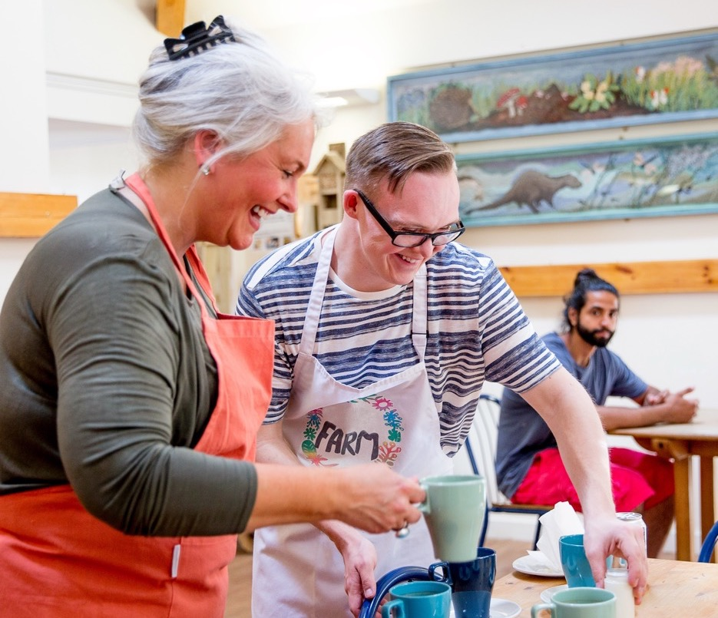



Reframing Commissioning |
Getting Transitions Right for Young Disabled People
NCAS Conference November 2025

Slide 2
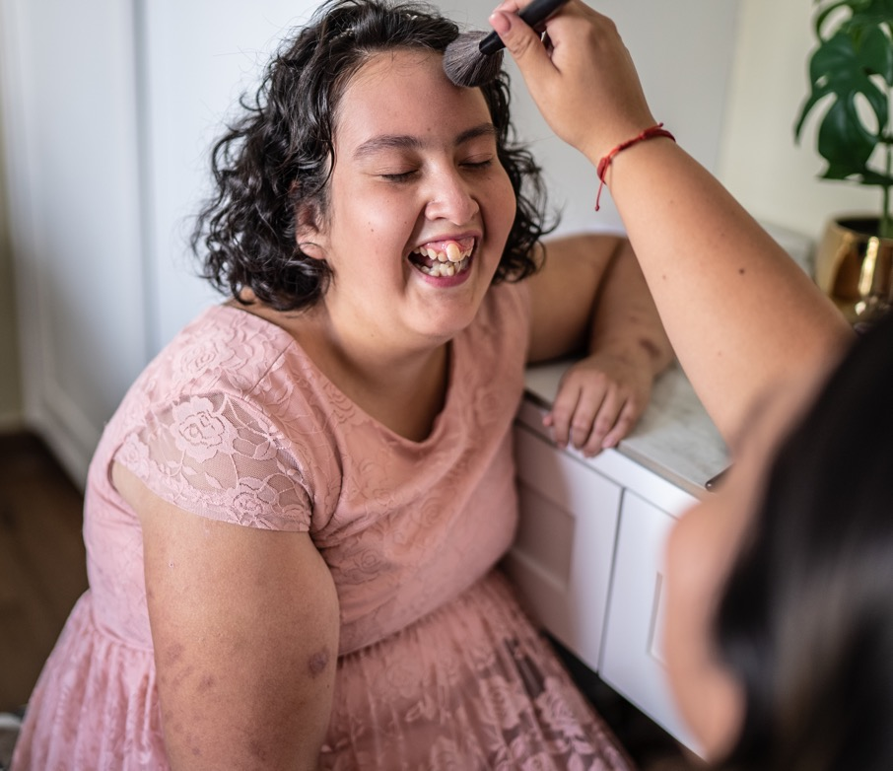

The QUESTION
“What if commissioning were built on trust instead of tenders?”
Notes:
RH

Slide 3




The challenge being faced today…
Demand is
Acuity of need is
Budgets in real terms
Transactional commissioning is
leading to fragmentation and
(unhealthy) market consolidation.
Notes:
We’ve all colluded in a system that’s failing, but we can fix it together…

Slide 4
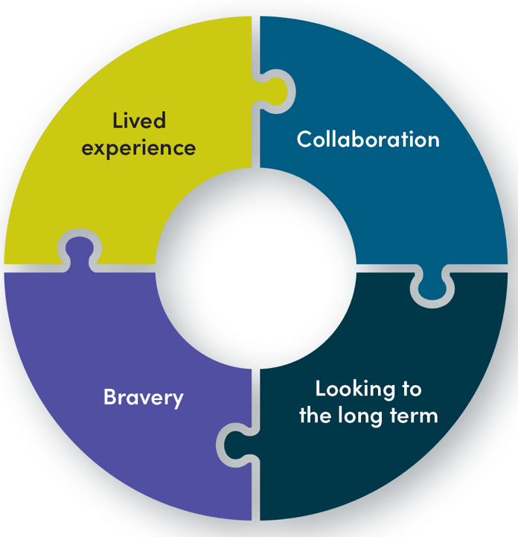

Reframing Commissioning
”Commissioning should start at gloriously ordinary life and what that means, what matters most to people’s lives – not KPIs or units of time.”
Notes:
RH
Millions of disabled people who draw on care and support rely on state-funded services and the valuable care workforce in order to lead independent and fulfilling lives.
We’re being told that accessing support, where and when disabled people choose, is becoming increasingly problematic.
We’re also hearing from VCSE organisations about the challenges they face in delivering statutory services on behalf of councils, due to a lack of funding, risk aversion, too tightly defined services and contracts and a lack of risk sharing.
But that isn’t the case everywhere.
VODG and Collaborate ran a series of conversations with providers, people with lived experience, commissioners, the LGA, ADASS, NHS Confederation and others in the sector about the shifts needed to reframe commissioning and a shared future vision, built on lived experience, collaboration, bravery and looking to the long term.

Slide 5

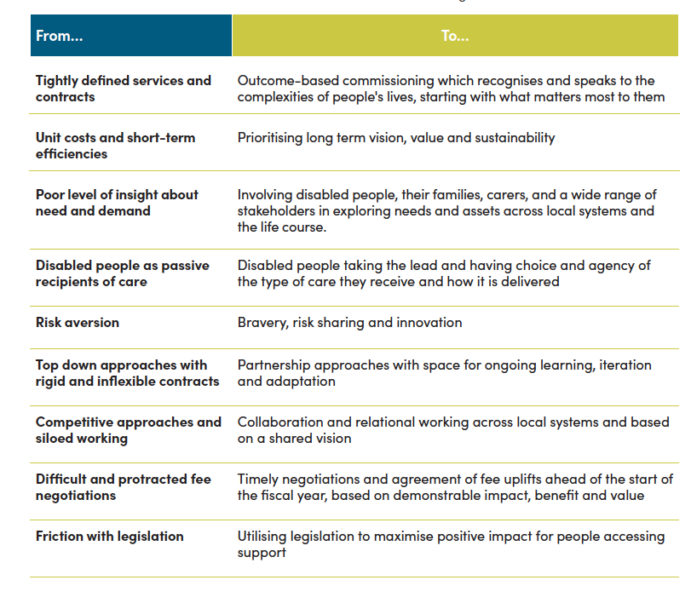
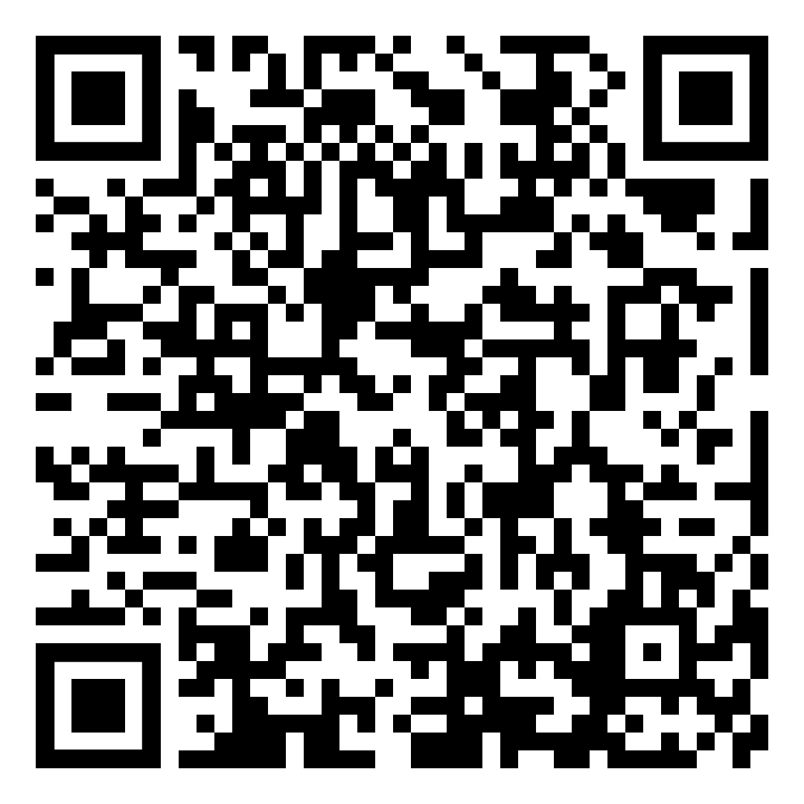
Shifting the conversation
VODG
Reframing Commissioning
Report:
Notes:
RH (no need to read the slide, just have it up)
This isn’t about having more money in the system but how we use what we have better by shifting the way we approach conversations, partnership and risk.

Slide 6
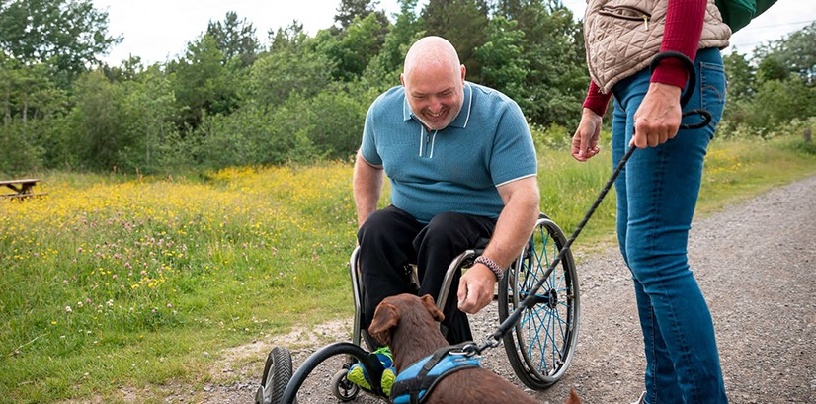
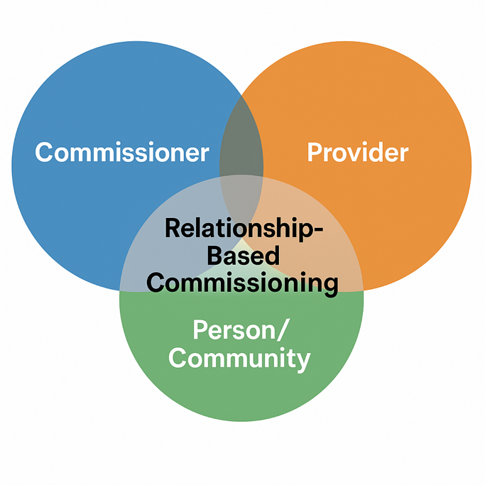

In practice we’re talking about
relationship-based commissioning.
This means…
Co-production over competition
Long-term shared outcomes
Mutual accountability
Shared risk
Community-rooted delivery
Notes:
RH

Slide 7

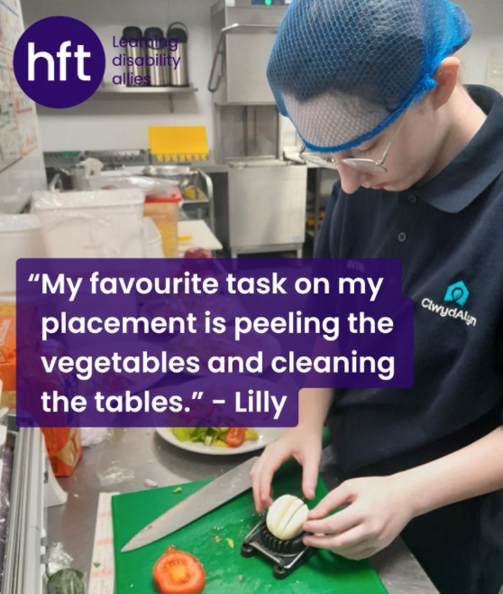

HFT - KWV Story; Before
Large Residential home - not fit for purpose
Good Partnership and trust with Central Bedfordshire Council
Co-designed idea:
Unmet need from Central Beds (Transition but not just static provision)
Available resources from Hft
Willingness to work together
The Transition service model is not exactly new. The working relationship with the local authority, and a commitment from the authority to ensure supported people have a pathway to move into long-term accommodation at the end of their transition pathway, when they may be deemed as “appropriately housed” is what's new.
  Ian Eary
  Regional Service Manager - Hft
Notes:
SV

Slide 8


KVW – The Model
Resi Care Home -> 4 self contained flats + shared training space for life skills
refurbishment fully funded by Hft
Personalised tech and 1:1 intensive support, which reduces over time
3 – stage pathway: Outreach -> Transition -> Move on
Focus on 4 life domains: health, employment, home, relationships
Notes:
SV

Slide 9


The outcomes and learning
Over 20 young people supported since opening
Two people fully independent of paid care on exit, remaining all have average of 40% reduction on their care package from base line
Estimated saving of £500k pa and counting to Central Beds, since service opening.
The Big 5 – stability principle, reduced placement breakdown post move on AND improved community engagement / informal support are all what the voluntary sector do well.
Partnership with LA Housing Officers to make sure move on options available is key.
Notes:
SV

Slide 10



Will’s Story – What changed for me.
  William Hart
  Expert by lived experience
    “If it weren’t for Hft’s Transition Service; KWV, then I simply wouldn’t be living the life I live at the moment, and that’s a scary thought”
Notes:
WH
Prompt questions
What did your circle of support look like before the transition service?
How did the transition service become an opportunity for you?
How did the transition service impact your life?
What does your circle of support look like now that you have moved on from the transition service?
Optional question
Do you think transition services are an important aspect of social care for the future?

Slide 11
Cornwall’s Journey – Why change was needed
We were being driven by measuring outputs, responding to targets, price and process, competitive tenders and often inflexible contracts.
What we needed to succeed…..
“Strategic partnerships and a shared vision enable us to deliver sustainable, high-quality care for our communities.”
  Karen Hooper,
  Head of Commissioning for Working Age Adults
Sustainable Service Growth
Cross Sector Alignment
Together, we build sustainable and responsive services that set foundations for future growth and improvement.
Aligning efforts across different sectors maximises the impact of initiatives and implementing innovative strategies is essential for maintaining high-quality social care services effectively.
Collaborative Partnership
Cornwall Council and third sector providers collaborate effectively under shared principles to enhance care services.
Person-Centred Care Innovation
The partnership drives innovative approaches focused on person-centred care, improving service outcomes.
Notes:
KH

Slide 12


Communication
Co-Designed Service Models
Vision for Ongoing Collaboration and Sector Evolution
Sustained Partnership
  Ongoing collaboration is essential for building strong, long-lasting partnerships that support sector growth.
Responsiveness to Challenges
  Adapting to emerging challenges and opportunities maintains service relevance and impact.
Innovative Evolution
  Innovation drives the evolution of services to meet changing community needs effectively.
Collaborative Development
  Services are created jointly by users and providers, ensuring relevant and personalised solutions.
Responsiveness to Needs
  The model adapts services to meet individual preferences and specific requirements effectively.
Empowerment and Inclusion
  Co-designed services foster empowerment by involving users, promoting inclusivity and respect.
Regular Communication Channels
  Consistent communication between council and providers ensures clear information sharing and builds trust.
Transparency and Improvement
  Effective communication fosters transparency, promoting continuous enhancement of services and relationships.
Notes:
KH

Slide 13

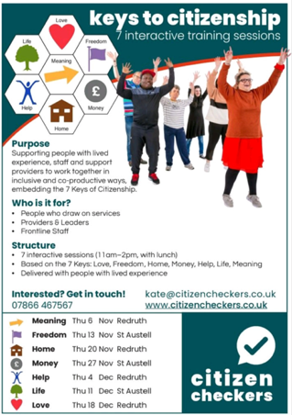


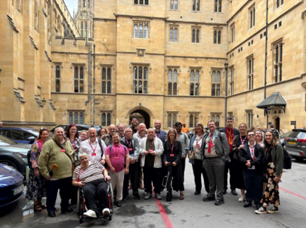





How are we doing now?
Emphasis on embedding citizenship into our commissioning cycle – lived experience leading from the front and developing the self-directed support tools needed – DPs / ISFs.
Driving coproduction, person centred performance measures and narrative reporting
New relational framework piloted with voluntary sector providers and peer advocates
Underpinned by excellent support material that informed the market what Cornwall was doing and why.
Accessible commissioners – ready to listen and learn – the art of trust and collaboration
Notes:
KH

Slide 14
Closing Reflections
Three takeaways (plus a sneaky fourth)
Relationships | Reframing commissioning | Opportunity
Voluntary Sector want to help, not hinder Adult to Adult, not commissioner to provider Relationships deliver better outcomes than rules | Commissioning is leadership through partnership Procurement is to keep you safe, but doesn’t need to be the block to doing things well New Proc Regs give “Competitive Flexible Procedure” – if needed | What are your challenges and issues? Do you have the solutions? If not, the VCSE WILL be doing it somewhere. Your next contract is an opportunity to do it differently
Fourth – Your residents will have a better experience, ask Will. ☺
Notes:
SV

Slide 15


Q&A
What would it take for your commissioning relationships to be based on trust?
Risk-Sharing
Leadership
Culture
Contract Flexibility
Resource
Notes:
RH

Slide 16
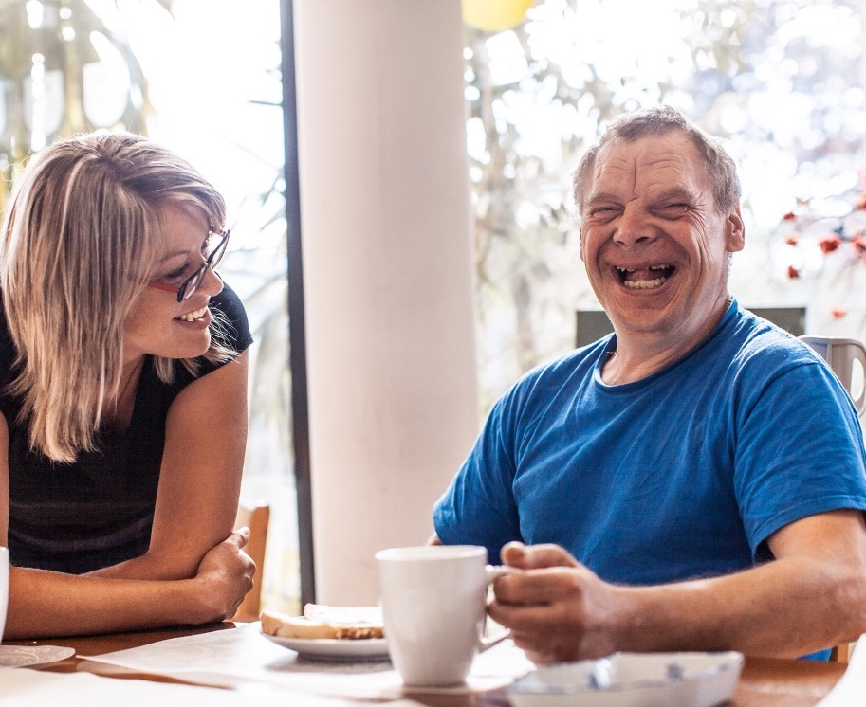

Thank You
Dr Rhidian Hughes
CEO - VODG
research.policy@vodg.org.uk
Stephen Veevers
CEO – Hft, Learning Disability Allies
Stephen.Veevers@hft.org.uk
Karen Hooper
Head of Commissioning for Working Age Adults
Karen.hooper@cornwall.gov.uk
Notes:
RH

