Slide 1
Personal Independence Payment
Disability Living Allowance for Children
Attendce Allowance
Carers Allowance

Slide 2
Personal Independence Payment (PIP)
Benefit provides cash contribution towards the extra costs associated with a long-term health condition or disability
Replaces Disability Living Allowance for people of working age (between 16 and State Pension Age)
Entitlement based upon assessments of impact on ability to carry out daily living and mobility activities
Assessments undertaken by Health Professionals employed by external providers
Notes:
Slide 2
Overview of Personal Independence Payment
This slide outlines basic purpose of PIP – potential claimants can be signposted to claim – more information about eligibility is available in the PIP Toolkit for support organisations – link provided on the final slide of this pack.
PIP is for adults aged 16 to 64, DLA remains for children up to the age of 16, and DLA recipients aged 65 or over (on 8 April 2013 – the day PIP was introduced)
There are no automatic entitlements to PIP - Entitlement to PIP will be based on the effect a long-term health condition or disability has on the claimant’s daily life it is not based on the type of condition/illness or disability they have
PIP is not means tested or taxed and can be paid whether the recipient is working or not
Individuals must have needed help for at least three months and to be likely to need it for at least another nine months
More details about how PIP works can be found on slide 7 of this pack

Slide 3
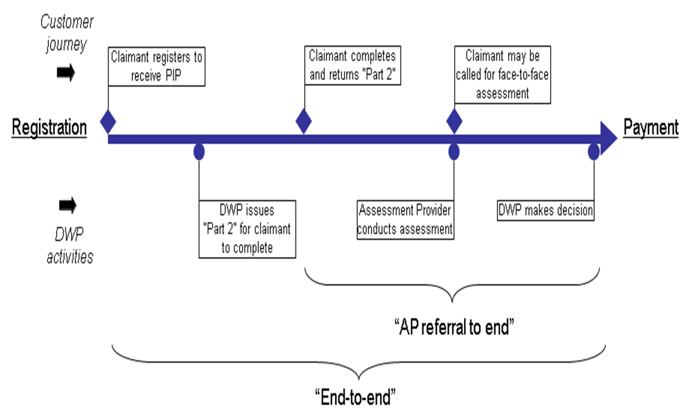
PIP claimant journey

Slide 4
Components and Eligibility
PIP will be made up of two components – daily living and mobility
Each can be paid at standard rate, or enhanced rate for those with the greatest needs
The PIP assessment criteria will consider the
individuals’ ability to carry out a range of everyday activities
Individuals will receive a point score for each activity, depending on how well they can carry them out and the help they need to do them
The total scores for each component determine whether a component is payable, and if so, whether at the standard or enhanced rate
Daily Living
Mobility
Enhanced
Enhanced
12 points
Standard
Standard
8 points
Not Entitled
Not Entitled
PIP Toolkit – Conditions of Entitlement

Slide 5
Assessment Criteria
Daily living component (activities 1-10) |  | Mobility component (activities 11-12)
Standard rate = 8 points Enhanced rate = 12 points |  | Standard rate = 8 points Enhanced rate = 12 points
Activity | Possible points | Activity | Possible points
1. Preparing food | 0-8 | 11. Planning and following journeys | 0-12
2. Taking nutrition | 0-10 | 12. Moving around | 0-12
3. Managing therapy or monitoring a health condition | 0-8
4. Washing and bathing | 0-8
5. Managing toilet needs or incontinence | 0-8
6. Dressing and undressing | 0-8
7. Communicating verbally | 0-12
8. Reading and understanding signs, symbols and words | 0-8
9. Engaging with other people face-to-face | 0-8
10. Making budgeting decisions | 0-6
Notes:
Slide 9
Assessment Criteria
There are 12 assessment criteria that take into account whether activities can be carried out safely, to an acceptable standard, repeatedly and in a reasonable time period.
Individuals will receive a point score for each activity, depending on how well they can carry the activity out and the help they need to do so. The total scores will determine whether a component is payable, and if so, whether at the standard or enhanced rate. The point thresholds for both components are 8 points for the standard rate and 12 points for the enhanced rate.
The DWP Decision Maker makes the final decision, using all the relevant evidence they have – including the health professional’s report
More information about the PIP Assessment criteria and how this is applied can be found in the PIP assessment guide – a link to this has been provided on the final slide of this pack

Slide 6
PIP Payable Amounts
Daily Living Component -
Enhanced rate £108.55
Standard rate £72.65
Mobility Component –
Enhanced rate £75.85
Standard rate £28.70

Slide 7
Attendance Allowance

Slide 8
What is Attendance Allowance
Attendance Allowance is a benefit paid to people who are of State Pension age who have care needs, to help with the extra costs of long term illness or disability
Attendance Allowance can be paid regardless of your income, savings or National Insurance contribution record and is a tax free benefit
Getting Attendance Allowance does not reduce other benefits, it may even increase them
Attendance Allowance will not apply to:
- people who are between 16 and State Pension Age, who should claim the Personal Independence Payment (PIP)
- people of State Pension who are already in receipt of DLA or PIP

Slide 9
Who can claim Attendance Allowance
To qualify for Attendance Allowance you must meet all of the following criteria:
the age of entitlement will raise in line with the increase in State Pension age, between 6th December 2018 and October 2020 from 65 years to 66 for both men and women a claim can only be made once people are State Pension age and over.
  need help looking after yourself because you have a disability or mental illness, sensory impairment
have had the disability or illness for at least six months (you can make your claim before the six months have passed, but you will not receive any payment until they have)
meet the residence and presence conditions - must have been present in Great Britain for 104 weeks out of the 156 weeks before claiming (two out of the last three years).

Slide 10
How much is Attendance Allowance
There are two rates of Attendance Allowance:
Higher £108.55
Lower £72.65
You will be paid the higher rate of Attendance Allowance if you meet one of the following criteria:
- you satisfy both the daytime and night-time tests
-you are terminally ill (someone is classified as terminally ill if
they are not expected to live longer than 6 months)
You will be paid the lower rate of Attendance Allowance if:
- you satisfy the daytime or night-time tests

Slide 11
Benefit helplines
Attendance Allowance
0800 731 0122 Textphone 0800 731 0317
Carer’s Allowance Unit
www.gov.uk/carers-allowance
0800 731 0297 Textphone 0800 731 0317
Information is also available on line at the gov.uk website.

Slide 12
Disability Living Allowance for Children

Slide 13
Disability Living Allowance (DLA) for children may help with the extra costs of looking after a child who:
Is under 16
Has difficulties walking or needs much more looking after than a child of the same age who does not have a disability
There are two parts to DLA Child - the Mobility Component and the Care Component.
It is a non-means tested benefit and can be a passport to other benefits like carers allowance.

Slide 14
Eligibility
Usually, to qualify for Disability Living Allowance (DLA) for children the child must:
be under 16 - anyone over 16 must apply for Personal Independence Payment (PIP)
need extra looking after or have walking difﬁculties
The child must have had these difficulties for at least 3 months and expect them to last for at least 6 months.
be in England, Wales, a European Economic Area (EEA) country or Switzerland when you claim - there are some exceptions, such as family members of the Armed Forces
be habitually resident in the UK, Ireland, Isle of Man or the Channel Islands
not be subject to immigration control
have lived in Great Britain for at least 6 of the last 12 months, if over 3 years old.
There are special rules for end of life if the child is not expected to live more than 12 months.
en

Slide 15
Rates
Care Component
Highest £108:55
Middle £72.65
Lowest £28.70
Mobility Component
Higher £75.85
Lower £28.70

Slide 16
How to Claim
To claim DLA for a child you need to be their parent or look after them as if you’re their parent.
To apply you can either:
Print off and fill in the DLA claim form on www.gov.uk
Phone the Disability Living Allowance helpline and ask for a printed form
Telephone: 0800 121 4600
Textphone: 0800 121 4523
Monday to Friday, 9am to 5pm
Alternative formats are available:
Relay UK (if you cannot hear or speak on the phone): 18001 then 0800 121 4600
Video Relay Service for British Sign Language (BSL) users

Slide 17
Useful Evidence
Carers Diaries
Diagnostic Tools e.g. Autism
Educational Health Care Plans
Current Occupational Therapist Reports
Speech and Language Assessments
Current care plans
GP Patient Records
Support letters
Current Carers Assessments
Prescription
Current Psychological reports
Evidence from support workers
Healthcare reports

Slide 18
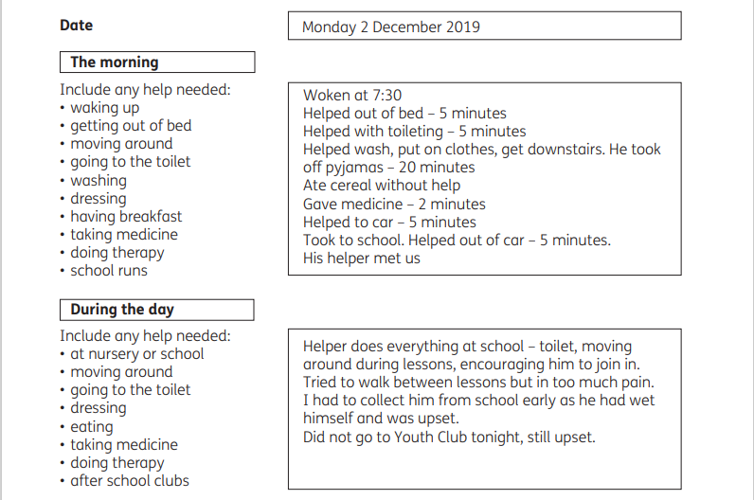

Slide 19
Care Component
The rate the child gets depends on the level of looking after they need, for example:
Lowest rate - help for some of the day
Middle rate - frequent help or constant supervision during the day, supervision at night or someone to help while they’re on dialysis
Highest rate - help or supervision throughout both day and night, or deemed as Special Rules End of Life
Consider all the circumstances when the child requires care, i.e. at home, at school, undertaking hobbies/ interests etc.

Slide 20
If the claim is awarded
DLA can be paid from the start of your claim. It cannot be backdated.
The claim will start on the date the form is received or the date a call was made to the enquiry line (if claim pack is returned within 6 weeks)
DLA is usually paid every 4 weeks
Payments will be made into a bank or building society
DLA Child can be a passport benefit to extra support

Slide 21
Change of circumstances
You must contact the Disability Living Allowance (DLA) helpline if:
your child’s personal details change, for example their name, address or doctor
the help they need or their condition changes
their condition has worsened and they’re not expected to live more than 12 months
they go into hospital or a care home
they go abroad
they’re imprisoned or held in detention
their immigration status has changed, if they’re not a British citizen
Parent/ guardians personal details change for example their name, address

Slide 22
Mandatory Reconsideration
You can request a Mandatory Reconsideration (MR) if you dispute a decision made. This should be done within one calendar month from the date of the decision.
You can do this by phone, in writing or by downloading and printing off a CRMR1 form from the internet. Additional evidence can also be provided.
You can phone and ask for an explanation of the decision and a statement of reasons.
A new Case Manager will look at all the available evidence and make a decision.
A Case Manager can decide to leave the level of award the same, increase an award and in some cases decrease the award.
CRMR1 - Challenge a decision made by the Department for Work and Pensions (DWP) - GOV.UK

Slide 23
Renewals
The majority of DLA Child awards will be subject to review at set intervals, decided by the case manager when the original decision was made.
We will contact the customer and send out a renewal pack 20 weeks before the award ends and invite them to re-apply.
The onus is on the Parent/ Guardian to make the renewal claim.
Once the claim is made it will be classed as a new claim.

Slide 24
When your child turns 16
Your child will need to apply for Personal Independence Payment (PIP).
Your child will get a letter inviting them to apply for PIP:
Shortly after their 16th birthday
When they leave hospital, if they were in hospital on their 16th birthday or
About 20 weeks before their DLA award ends, if they were awarded DLA under Special Rules End of Life
Preparation for PIP application: https://www.gov.uk/guidance/the-personal-independence-payment-pip-toolkit

Slide 25
Top Tips
Don’t delay making an application.
Take your time and don’t try to finish the form in one go. Read through it first so you have an idea of what’s needed and use the help booklet for guidance and support.
Get specialist advice from a welfare benefits adviser or someone else who is familiar with completing the form. The help booklet signposts to organisations.
Don’t play down your child’s condition. Include a description of their needs on the bad days as well as on better days.
Include evidence with the form if possible and use examples and anecdotes to describe your child’s needs. Include hobbies, activities and interests that your child has and what extra help and support they need to allow them to do these.
Include all information about the location of the child such as being in hospital or a residential school or care home.
.
This Photo by Unknown Author is licensed under CC BY-NC

Slide 26
Top Tips continued
You may wish to consider attaching extra sheets of paper with additional information in order to capture the complexity of your child’s needs.
Complete the nationality information for both child and parent / guardian and make sure you sign the form.
Read through the form before you send it. Have you included enough information? Have you answered all the relevant questions? Are your contact details correct? Have you missed anything? Is the professionals’ evidence complete? Then ask yourself – have you included enough detail to demonstrate to someone who hasn’t met your child they have additional needs?
If you know you’re sending the form in late, include the reasons why within the form.
Keep a copy of the claim pack and any documents you send in.
If awarded DLA be aware of the award end date and when you will need to start to prepare for the renewal process or move to PIP and remember you must report any change of circumstances during the life of the claim.
This Photo by Unknown Author is licensed under CC BY-NC

Slide 27
Carers Allowance

Slide 28
Introduction
Non-contributory, but earnings related.
Taxable.
Claim form DS700 can also claim on line via the www.dwp.gov.uk – much shorter process
Weekly rate is £81.90 per week
Receiving certain other entitlements will have an impact on Carers Allowance eg underlying entitlement

Slide 29
Who is entitled?
A customer aged 16 or over who spends at least 35 hours a week looking after someone receiving:
Attendance Allowance
Disability Living Allowance (at the highest or middle rate of care component).
Personal Independence Payment (daily living component)
Carer’s Allowance is not payable if the customer is in full-time education of 21 hours or more each week
Cannot earn more than £120.00 per week (from 11/4/2018) net after allowable expenses.

Slide 30
Other information
Carer’s under State Pension age are entitled to class 1 National Insurance credits for each week they are paid CA.
Carers Credit has no monetary reward but, will again give the carer a National Insurance contribution towards their own State Pension.
Must be caring at least 20 hours no limit to the number of claimants.

Slide 31
Universal Credit
Universal Credit is a monthly payment to help with your living costs.
You may be able to get it if you’re on a low income or out of work.
You might get an extra amount of Universal Credit if you have a health condition or disability that limits
how much work you can do. The Department for Work and Pensions (DWP) refers to this as your ‘capability to work’.
Your monthly payment is based on your circumstances, for example your health condition or disability, income and housing costs.
Find out if you’re eligible for Universal Credit

Slide 32
Applying for UC
How to claim
You can apply for Universal Credit online.
You need to create an account to make a claim. You must complete your claim within 28 days of creating your account or you will have to start again. Your claim starts on the date you submit it in your account.
If you live with your partner, you will both need to create accounts. You’ll link them together when you claim. You cannot claim by yourself.
If you cannot claim online, you can claim by phone through the Universal Credit helpline.
Check if you’re better off on Universal Credit before you apply
If you already get benefits or tax credits, you should work out if you’ll be better off before you or your partner claim Universal Credit.
If you apply for Universal Credit those benefits might end and you will not be able to apply for them again, even if your application is not approved.
To check if you’re better off, you can:
use a benefits calculator
contact the Citizens Advice Help to Claim service
ask a local benefits adviser

Slide 33
Help with UC Claim
Help with your claim
There are 2 ways to get help with your Universal Credit claim. You can either call the Universal Credit helpline or use the Help to claim service.
Calls to the Universal Credit helpline are free.
Universal Credit helpline
Universal Credit helpline
Telephone: 0800 328 5644
Welsh language: 0800 328 1744
Relay UK (if you cannot hear or speak on the phone): 18001 then 0800 328 5644
British Sign Language (BSL) video relay service if you’re on a computer - find out how to use the service on mobile or tablet
Textphone: 0800 328 1344
Monday to Friday, 8am to 6pm
Find out about call charges

Slide 34
Applying for UC
What you need to apply
To apply online you’ll need:
your bank, building society or credit union account details
an email address
access to a phone
If you do not have these, you can call the Universal Credit helpline or go to a jobcentre. You can also get support from the Citizens Advice Help to Claim service.
You’ll also have to prove your identity. You’ll need some identity documents for this, for example your:
driving licence
passport
debit or credit card
payslip or P60

Slide 35
Applying for UC
To complete your claim you will need to provide information about:
your housing, for example how much rent you pay
your earnings, for example payslips
your National Insurance number, if you have one
other benefits you get
any disability or health condition that affects your work
how much you pay for childcare if you want help with childcare costs
your savings and any investments, like shares or a property that you rent out
You might need an appointment with the Universal Credit team if:
they need more information
you cannot verify your identity online
You’ll be told if this appointment will be in a jobcentre or on the phone.
You will have to go to a meeting to agree the activities in your claimant commitment before you can get your first payment.
Apply for Universal Credit online
Apply now

Slide 36
UC and reporting a health condition
Report your health condition or disability
When you apply for Universal Credit, you can report if you have a health condition or disability that affects your ‘capability to work’.
This could mean that you:
need support in work
need to find suitable work
are unable to work temporarily or long term
You can still work if you feel able to or if you find suitable work. Find out more about getting Universal Credit if you work.
How to report your health condition or disability
You’ll need to provide details about your health condition, such as:
medical treatments you’re receiving
if you’re in or expecting to go into hospital
if you’re pregnant

Slide 37
Other Support
Other support you can get
You may also be eligible for New Style Employment and Support Allowance.
Check if you can get other financial support.
If you might have 12 months or less to live
You may get extra money for Universal Credit if a medical professional has said you might have 12 months or less to live.
If you’re making a new claim, you can declare this during your application. If you’ve already made a claim, you’ll need to report this as a change of circumstances.
You will not usually need a Work Capability Assessment.
Find out more about getting benefits if you’re nearing the end of life.
Next:Report your health condition or disability

Slide 38
Access to Work: get support if you have a disability or health condition
What Access to Work is
Access to Work can help you get or stay in work if you have a physical or mental health condition or disability.
The support you get will depend on your needs. Through Access to Work, you can apply for:
a grant to help pay for practical support with your work
support with managing your mental health at work
money to pay for communication support at job interviews
This guide is also available in Welsh (Cymraeg), British Sign Language (BSL) and Easy Read format.

Slide 39
Practical support with your work
Access to Work could give you a grant to help pay for things like:
specialist equipment and assistive software
support workers, like a BSL interpreter, a job coach or a travel buddy
costs of travelling to work, if you cannot use public transport
adaptations to your vehicle so you can get to work
physical changes to your workplace
Your workplace can include your home if you work from there some or all of the time.
It does not matter how much you earn. If you get an Access to Work grant, it will not affect any other benefits you get and you will not have to pay it back.
You or your employer may need to pay some costs up front and claim them back later.
How to apply
Check you’re eligible and then apply for an Access to Work grant.

Slide 40
Mental Health Support
Mental health support
You can get support to manage your mental health at work, which might include:
a tailored plan to help you get or stay in work
one-to-one sessions with a mental health professional

Slide 41
How to apply
Check you’re eligible and then apply directly to either Able Futures or Maximus.
Communication support for job interviews
Access to Work can help pay for communication support at a job interview if:
you’re deaf or hard of hearing and need a BSL interpreter or lipspeaker
you have a physical or mental health condition or learning difficulty and need communication support
Find out more and apply for communication support at a job interview.
What Access to Work will not pay for
Access to Work will not pay for reasonable adjustments. These are the changes your employer must legally make to support you to do your job.
Access to Work will advise your employer if changes should be made as reasonable adjustments.

Slide 42
Eligibility
As part of Access to Work, you may be eligible for:
a grant to help pay for practical support with your work
support with managing your mental health at work
For these types of support, you must:
have a physical or mental health condition or disability that means you need support to do your job or get to and from work
be 16 or over
be in paid work (or be about to start or return to paid work in the next 12 weeks)
live and work (or be about to start or return to work) in England, Scotland or Wales - there’s a different system in Northern Ireland
There are different eligibility criteria for communication support at a job interview.

Slide 43
Your disability, illness or health condition
You must have a disability, illness or health condition that means you need support to do your job.
This can include, for example:
a physical disability, for example if you’re hard of hearing or use a wheelchair
a learning disability or related condition, for example if you have Down’s syndrome
a developmental condition, like autism spectrum disorder
having ADHD or dyslexia
an illness such as diabetes or epilepsy
a temporary condition, like a broken leg
a mental health condition, for example anxiety or depression
You do not need to be diagnosed with a condition to apply.

Slide 44
Your Work
You need to have a paid job (or be about to start or return to one).
A paid job can be full or part-time and can include:
employment
self-employment
an apprenticeship
a work trial or work experience
an internship
a work placement
You cannot get Access to Work support for voluntary work.
You can still apply for Access to Work if you’re working from home some or all of the time.

Slide 45
Your income and benefits
.
You can get support from Access to Work:
however much you earn or have in savings
at the same time as most benefits, as long as you work more than 1 hour a week
If you’re getting Employment and Support Allowance (ESA)
You can get Access to Work and ESA at the same time if you work less than 16 hours a week. There are rules about working while claiming ESA. You can ask your work coach for advice and support

